Slide 1




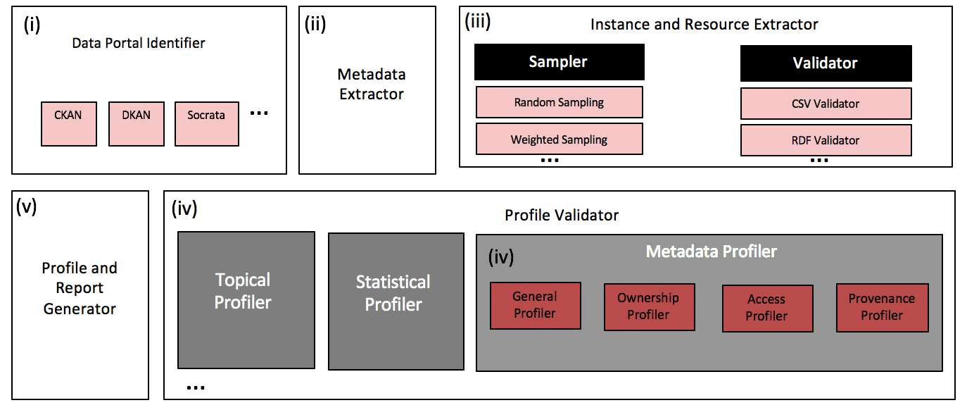
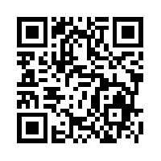
Roomba
Automatic Validation, Correction and Generation of Dataset Metadata - Enhancing Dataset Search and Spam Detection
Ahmad Assaf†, Raphaël Troncy† and Aline Senart‡
†EURECOM
Sophia Antipolis, France
firstName.lastName@eurecom.fr
‡ SAP Research, SAP Labs France SAS
Mougins, France
aline.senart@sap.com
Data Portals
A curated collection of metadata about datasets providing discovery functionality to complement conventional browse-style catalogue interfaces
General information
Ownership information
Access information
Provenance information
Running Roomba on the LOD Cloud:
41% of the ownership information is missing
64% of the resources metadata is missing
44% of the top metadata problems fixed automatically
All results are reproducible from our code base at https://github.com/ahmadassaf/opendata-checker
This research has been partially funded by the European Union's 7th Framework Programme via the project Apps4EU (GA No. 325090)

